Slide 1

WELCOME
Bob Gemmell
ERIC West Sub-fund Administrator
NJSIG
Public Entity Leader, VP
Brown & Brown
ERIC West
In-Person Meeting
School Athletics: A Comprehensive Plan for Addressing Legal Liability and Promoting Student Safety
Friday, May 9, 2025

Slide 2
WELCOME
Dominick Cinelli
ERIC West Sub-fund Administrator
NJSIG
Senior VP
Brown & Brown
Bob Gemmell
ERIC West Sub-fund Administrator
NJSIG
Public Entity Leader, VP
Brown & Brown
SUB-FUND ADMINISTRATOR REPORT
ERIC West
In-Person Meeting
School Athletics: A Comprehensive Plan for Addressing Legal Liability and Promoting Student Safety
Friday, May 9, 2025

Slide 3
ADDITIONAL LOSS CONTROL SERVICES AVAILABLE:
LOSS CONTROL/TOOL BOX SESSIONS THROUGH ZYWAVE
  SENT BI-MONTHLY
BROWN & BROWN WEBINAR CATALOGUE
ERIC WEST TOPIC SPECIFIC WEBINARS
  IAQ PRIOR TO SUMMER BREAK
SUB-FUND ADMINISTRATOR REPORT
ERIC West
In-Person Meeting
School Athletics: A Comprehensive Plan for Addressing Legal Liability and Promoting Student Safety
Friday, May 9, 2025

Slide 4
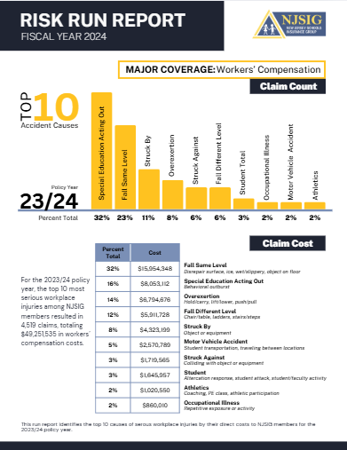
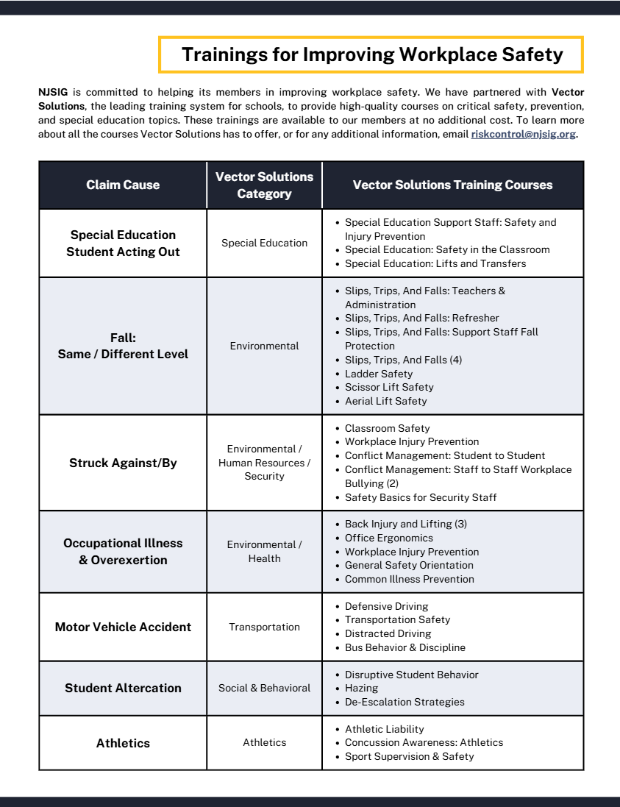
NJSIG EXECUTIVE UPDATE
NJSIG UPDATE
Joseph Semptimphelter
Senior Business Development Specialist
jsemptimphelter@njsig.org
609-386-6060 x3044
RISK RUN REPORT

Slide 5
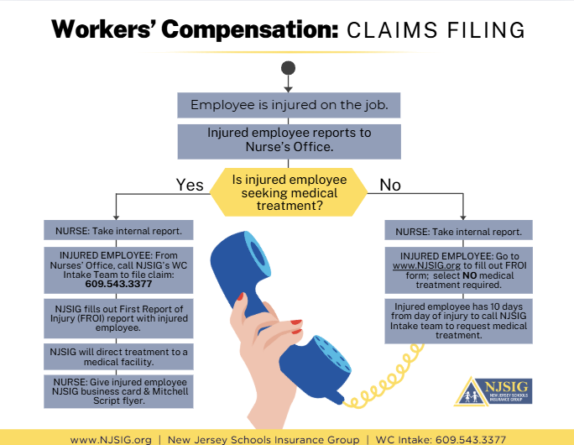
SUB-FUND ADMINISTRATOR REPORT
NJSIG UPDATE
NJSIG UPDATE
Joseph Semptimphelter
Senior Business Development Specialist
jsemptimphelter@njsig.org
609-386-6060 x3044
NJSIG EXECUTIVE UPDATE
RISK RUN REPORT
RECENT INTAKE TRAINING

Slide 6
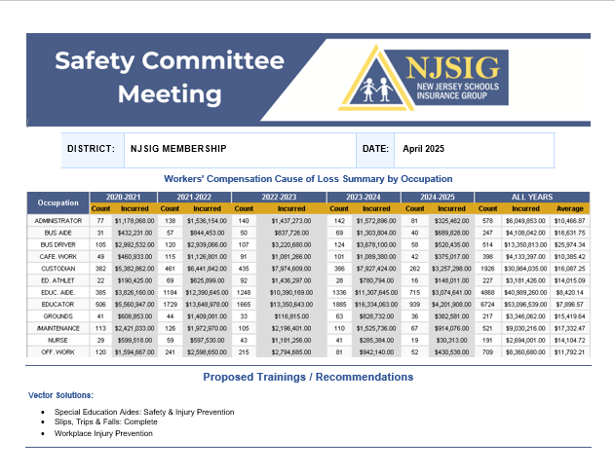
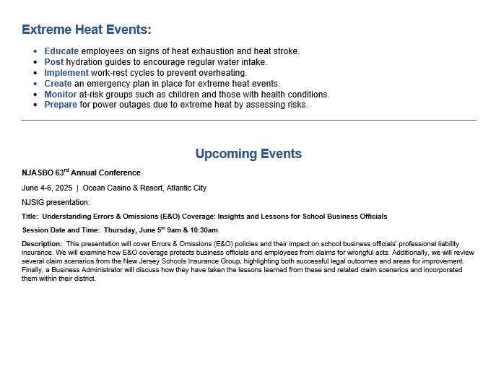
SUB-FUND ADMINISTRATOR REPORT
RISK RUN REPORT
NJSIG EXECUTIVE UPDATE
RECENT INTAKE TRAINING
SAFETY FLYER

Slide 7
SUB-FUND ADMINISTRATOR REPORT
RECENT INTAKE TRAINING
NJSIG EXECUTIVE UPDATE
SAFETY FLYER
PRESENTATION
School Athletics: A Comprehensive Plan for Addressing Legal Liability and Promoting Student Safety
David Nash, Esq. LEGAL ONE/Director of Legal Education and National Outreach, Foundation for Educational Administration | Jeffrey Gale Director, Office of School Preparedness and Emergency Planning, NJDOE
Sandra Mamary Assistant Director, New Jersey State Interscholastic Athletic Association | Rebecca Gold LEGAL ONE Consultant

Slide 8
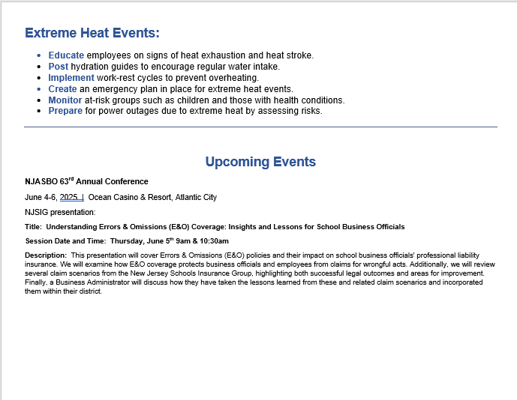
SAFETY FLYER
Latonya Brennan | Dan Regan | Barbara Fitzpatrick
Amanda DeNapoli | Eva Jakowluk
NJSIG EXECUTIVE UPDATE
PRESENTATION
School Athletics: A Comprehensive Plan for Addressing Legal Liability and Promoting Student Safety

Slide 9
Presenters
David Nash, Esq., Director of Legal Education and National Outreach/LEGAL ONE
Sandra Mamary, Assistant Director, New Jersey State Interscholastic Athletic Association
Geta Vogel, LEGAL ONE Coordinator of Mental Health, Wellness and the Law

Slide 10
Great Partnership
LEGAL ONE partnership with New Jersey Schools Insurance Group
The LEGAL ONE Podcast
  For More Information - https://www.thelegalonepodcast.com/
  New Episodes Coming in May!
  Athletics and Legal Liability

Slide 11
DISCLAIMER
This presentation is intended as a summary of law only and is not meant as legal advice. Please consult your attorney to obtain legal advice.
Participants are authorized to use the LEGAL ONE materials provided in this training to offer turnkey training within the respective participant's school district or place of employment, provided that participants provide proper credit to LEGAL ONE for having developed said materials and further provided that such turnkey training is offered at no charge.

Slide 12

Presentation Materials
Today’s document(s) can be accessed at
https://tinyurl.com/LO-ERICWest-250509
This folder can be accessed for 30 days from the session date.
Please download all files before the link expires.

Slide 13
Key Topics
Impact of Shifting Federal Priorities
Behavior Issues Involved Students, Parents, Spectators, and Staff
Recruiting, Screening, and Training Athletics Staff and Volunteers
Student Athlete Physical and Mental Health
Athletics and School Finance
Threat Assessment and Athletics
Key Takeaways

Slide 14
Why this Matters?
Athletics is crucial protective factor for promoting student engagement, safety, sense of belonging
Failure to follow legal requirements and best practices can result in:
  Devastating harm for students
  Serious discipline and other repercussions for staff members
  Significant liability for school districts

Slide 15
Impact of shifting federal priorities

Slide 16
Shifting Federal Priorities
See Article, Shifting Federal Priorities and the Impact on New Jersey School Law and Finance
Executive Order v. Regulation v. Statute v. Constitution
  EO must be consistent with regs, statutes, constitutional rights
State Law v. Federal Law
  Education is primarily a state responsibility, but potential impact on federal funding
Withholding of Funding
  Cannot impound funds that have been approved
Case Law
  Title IX decision
  Pending litigation challenging EOs

Slide 17
Dear Colleague Letter and Response
February 14 – USDE issues Dear Colleague letter directing K-12 and Higher Ed cease all DEI initiatives
February 28 – USDE provides FAQs to clarify and justify Feb 14 letter, purported legal authority
March 6 – NJ joins with coalition of states to provide response to USDE guidance
April 3 – US Dept of Ed DEI memo, funding threat
April 17 – NJ Response to DEI memo
April 25 – NJ joins 18 other states suing over DEI directive

Slide 18
Ongoing Obligations Related to DEI
Ensure non-discrimination based on protected characteristics and respond to alleged incidents
Address issues related to DEI in curriculum, K-12, per P.L. 2021, c. 32 and NJ Student Learning Standards
Ensure access to diverse and inclusive materials per the Freedom to Read Act (effective as of December 2025)
Identify and address district policies that involve disparate treatment or have a disparate impact on one or more protected classes (e.g., under-representation in gifted programs, over-representation in student discipline)

Slide 19
Scope of Title IX
Covers all public schools and institutions of higher education
Addresses discrimination linked to gender
DOES NOT require precisely same dollars or same number of male and female students, but DOES require equitable opportunities, comparable quality of facilities and equipment
Protections both students AND staff members
Protects against retaliation for reporting issues
  e.g. Jackson v. Birmingham Public Schools, 544 U.S. 167 (2005)
  Coach could not be fired for complaining about inequitable treatment of girls basketball team
Overlaps with other laws, provides additional due process for parents
Reverted back to 2020 Regulations which does not extend Title IX protections to transgender athletes. HOWEVER …

Slide 20
Gender Identity & Athletics
NJSIAA
  Transgender student shall be able to participate in accordance with birth sex or gender identity
    Same as NJDOE Transgender Student Guidance for School Districts
  Only legitimate challenges are safety and/or fairness in competition
  Situations determined on case-by-case basis
  Policy – See pp 44-45: https://www.njsiaa.org/sites/default/files/documents/2024-08/njsiaa-policies-and-procedures-24-25-.pdf
  FAQ: https://www.njsiaa.org/sites/default/files/documents/2020-10/transgender-faqs-approved-11-15-17.pdf

Slide 21
Addressing Gender Identity
See February 10, 2025 – Superior Court of NJ Decision
  Platkin v. Middletown Township BOE (restraining district policies inconsistent with NJDOE guidance regarding parental notice)
    file:///F:/Title%20IX/Title%20IX%20-%20Feb%2010,%202024/NJ%20Transgender%20Policy%20Decision%20-%20February%202025%20-%20a0037-23a0046-23a0118-23.pdf
P.L. 2017, c. 137 - Required NJDOE to develop guidance
NJDOE Guidance and Resources Regarding Transgender Students
Definitions – e.g., gender identity, gender expression, sexual orientation, cisgender, transgender
2018 Guidance makes clear schools honor what student tells them regarding gender identity
Parental consent not required
Need to ensure student is not “outed” to others, include parents
Need to revise student records UNLESS doing so would out the student
Need to allow access to locker rooms, restrooms based on gender identity

Slide 22
Continue to …
Honor what students tell you regarding gender identity and follow NJDOE guidance
Allow students to participate in athletics based on gender identity per current NJSIAA Policy and NJLAD
Ensure equitable access to athletics for students regardless of gender, gender identity, sexual orientation, citizenship status

Slide 23
Behavior issues involving students, parents, spectators, and staff

Slide 24
Foreseeable Issues
Issues often occur at less structured times (in locker room, on the bus, waiting for a ride home).
Many incidents where coaches are accused of HIB, but there is no evidence of wrongdoing - making difficult decisions on playing time, making team, etc.
Failure to address bad behavior by spectators can lead to liability for district and coaches.
“Trash talk” can quickly escalate to HIB/discrimination.
Athletics staff are in a position of power in relation to student athletes that should not be abused.
Athletics staff may create student records, public records or material that is discoverable in civil litigation through electronic communications, even when using personal devices
When school staff members engage in HIB consequences may be extremely serious, including suspension or revocation of certificates, and even reduction in pension.

Slide 25
Duty to Supervise Students
On the Field/Court
  Dangers of “Trash Talk”
Less Structure Settings
  On School Grounds
  In the Locker Room
  On the Bus
  On the Sidelines
  Waiting for Pick Up
  Away from School Grounds

Slide 26
“Trash Talk” Escalated to HIB
H.P. o/b/o R.S. v. BOE of the Borough of Tenafly, Commissioner 3/26/2024
Parent appealed BOE decision that her freshman son committed an act of HIB against a fellow classmate. HIB complaint resulted from antisemitic comments and threats of physical harm made by R.S. during an exchange on Instagram with a Jewish student in January 2023; exchange followed text exchanges between R.S. and his classmate which included back-and-forth insults regarding the other’s perceived soccer skills. R.S. alleged that the Instagram messages were in response to sarcastic comments made about his soccer abilities.
ABS undertook investigation after the victim met with her guidance counselor to report R.S.’s antisemitic comments and threats made through a private message on Instagram; Crisis Team determined that R.S. needed a mental health clearance, which occurred.
Notes:
Cheng v. Rodas
School Ethics Commission
Decided: Sept. 23, 2015
Issue – Whether board president has unilateral authority to issue a Rice notice to the B/A.
Facts –
After consulting with the board attorney, board president issued Rice notice to B/A.
Board attorney advised that such authority derived from Persi v Woska
Rule –
Board President may unilaterally issue Rice notice to superintendent of schools
Analysis –
No written authority exists granting board president unilateral authority to issue Rice notice to any other than chief school administrator.
[E]xtending this unilateral authority to a Board President to interfere with the employment of a BA or a custodian is the grant of unbridled power ripe for abuse, in violation of the School Ethics Act.⁴ Conducting one’s office in such a manner would lead to violations of the statute, N.J.S.A. 18A:24.1(c), (e) and (i), for acting beyond the scope of a Board member’s authority, taking private action with the potential to compromise the Board or interfering with the proper performance of the employee’s duties.
The Respondent also argues that the legal advice the Board received insulates him from blame for his conduct. It does not. Each Board member undergoes ethics training and each is responsible for his own ethical conduct. That responsibility cannot be delegated or avoided.
Conclusion –
Here, where the Respondent was found to have violated N.J.S.A. 18A:12-24.1(e) for exceeding his authority as a Board member, the Commission finds that the penalty of reprimand is appropriate.
Persi v. Woska – Commissioner determined that board president unilaterally, or majority of the board could issue Rice Notice to CSA.

Slide 27
“Trash Talk” Escalated to HIB
H.P. o/b/o R.S. v. BOE of the Borough of Tenafly, Commissioner 3/26/2024
Instagram message was nasty, antisemitic and threatened the victim. ABS found that both the victim and R.S. made unfavorable comments to each other about who was better at soccer; however, R.S. made comments threatening to hurt the victim as well as antisemitic comments about her religion. ABS HIB report concluded that R.S.’s actions met all of the statutory requirements and constituted an act of HIB. R.S. received counseling and a very short suspension.
ALJ concluded that R.S.’s statements were specifically targeted at the victim’s religion, a distinguishing characteristic. Messages threatened physical harm on the victim with comparisons to Adolph Hitler and the Holocaust. Not just “trash talk”. R.S. escalated “trash talk” exchanges into hate speech.
ALJ concluded that BOE determination that R.S.’s conduct constituted HIB was not arbitrary, capricious or against the weight of the evidence. Commissioner concurred. BOE reminded to comply with 10 day hearing requirement.
Notes:
Cheng v. Rodas
School Ethics Commission
Decided: Sept. 23, 2015
Issue – Whether board president has unilateral authority to issue a Rice notice to the B/A.
Facts –
After consulting with the board attorney, board president issued Rice notice to B/A.
Board attorney advised that such authority derived from Persi v Woska
Rule –
Board President may unilaterally issue Rice notice to superintendent of schools
Analysis –
No written authority exists granting board president unilateral authority to issue Rice notice to any other than chief school administrator.
[E]xtending this unilateral authority to a Board President to interfere with the employment of a BA or a custodian is the grant of unbridled power ripe for abuse, in violation of the School Ethics Act.⁴ Conducting one’s office in such a manner would lead to violations of the statute, N.J.S.A. 18A:24.1(c), (e) and (i), for acting beyond the scope of a Board member’s authority, taking private action with the potential to compromise the Board or interfering with the proper performance of the employee’s duties.
The Respondent also argues that the legal advice the Board received insulates him from blame for his conduct. It does not. Each Board member undergoes ethics training and each is responsible for his own ethical conduct. That responsibility cannot be delegated or avoided.
Conclusion –
Here, where the Respondent was found to have violated N.J.S.A. 18A:12-24.1(e) for exceeding his authority as a Board member, the Commission finds that the penalty of reprimand is appropriate.
Persi v. Woska – Commissioner determined that board president unilaterally, or majority of the board could issue Rice Notice to CSA.

Slide 28
Duty to Supervise School Grounds
See Duty of Care at School - Dickens v. Township of Irvington Irvington BOE and Derek Strong Docket No. ESX-L-006221-15 (N.J. Super. Ct. Sept. 18, 2017)
Facts: 13 year-old girl fell and severely injured her left arm after jumping over a cable on her way to an athletic field for gym class.
The cable had been erected to prevent vehicles from entering the athletic field
Girl claimed that she had never been warned by teacher not to jump over cable, which she and her classmates had done previously on numerous occasions without incident

Slide 29
Dickens v. Irvington BOE cont’d
Outcome: Jury found plaintiff 25 percent liable for her injuries and the district 75 percent liable. $8 million award reduced accordingly to $6 million. No liability was found against the teacher
Question
  What reasonable measures could be taken to reduce potential for injury and legal liability?

Slide 30
Duty to Supervise Locker Room
Issues may include health and safety (roughhousing) code of conduct, HIB, hazing, sexual assault
Hazing can quickly get out of control
  Members of High Baseball Team Suspended Over Biting Incident
In light of well publicized 2014 locker room issue involving another district and the football team, NJDOE made clear expectation to supervise students “at all times”

Slide 31
Hazing as a Crime - MOA with Law Enforcement
Section 8.5. Hazing.
Hazing is a separate offense under N.J.S.A. 2C:40-3. Hazing is a disorderly persons offense when the conduct, other than competitive athletic events, may place another person in danger of bodily injury.
When serious bodily injury results, the offense is aggravated hazing, which is a crime of the fourth degree.
The consent of the person hazed is not a defense. N.J.S.A. 2C:40-4. Any other criminal conduct under the New Jersey Code of Criminal Justice also may be charged. N.J.S.A. 2C:40-5.

Slide 32
Hazing Definition under MOA
Section 4.5. Hazing.
Hazing is a process, based on tradition that is used by groups to maintain a hierarchy (i.e., a pecking order) within the group.
Regardless of consent, the rituals require individuals to engage in activities that are physically and psychologically stressful.
  These activities can be humiliating, demeaning, intimidating and exhausting, all of which results in physical or emotional discomfort.
Hazing is about group dynamics and proving one’s worthiness to become a member of a specific group.
  The newcomer, or victim, is hazed.
  Once accepted by the group, the victim becomes a bystander and watches others get hazed.
Eventually the bystander typically achieves senior status and power, and becomes a perpetrator.

Slide 33
Addressing Hazing
Identify situations where potential exists for hazing to occur
Ensure proper supervision of students involved in athletics, extra curriculars
Develop alternative means to honor tradition, recognize upper classmen/team leaders
Promote school climate that is respectful to all
Recognize some forms of hazing may be criminal in nature, require law enforcement notice

Slide 34
Legislative Update
P.L. 2021 c. 208 (8/24/2021) Requires BOE of school district with high school or middle school to provide a program for the enforcement of the policy against hazing and adopt appropriate penalties for violation of the policy
Penalties for violations of the policy may include:
  Withholding of diplomas or transcripts pending compliance with the rules;
  Rescission of permission for the organization or group, whose student members are being penalized under the anti-hazing policy, to operate on campus or school property or to otherwise operate under the sanction or recognition of the school district or nonpublic school; and
  Imposition of probation, suspension, dismissal, or expulsion.
A penalty imposed under this section shall be in addition to a penalty imposed for violation of any other school district or nonpublic school rule to which the violator may be subject.
Policy adopted shall apply to each act conducted on or off campus if the acts are deemed to constitute hazing.
New Jersey School Boards Association – Serving Local Boards of Education Since 1914

Slide 35
Addressing Conduct
Away from School
R.R. v. Shore Regional – student threatens another with a knife outside school, school able to take action
Levy v. Mahanoy – SCOTUS decision, too far to remove from JV cheerleading squad and softball team for use of improper language online
Anti-Bullying Bill of Rights – Is behavior outside school likely to cause substantial disruption in school
N.J.A.C. 6A:16-7.6 – Code for conduct away from school grounds - Is it necessary to act to protect health and safety, maintain order in school
G.D. M. v. Ramapo Indian Hills – school district’s student athlete contract went too far, unenforceable where there is not sufficient nexus to district
  See LEGAL ONE Video summarizing case and legal implications

Slide 36
Implications of Ramapo-Indian Hills decision for Board Policy
Cannot suspend or remove a student from sports or other extra-curricular activities solely because the student was involved in use of alcohol or drugs off school grounds, or engages in criminal activity or juvenile delinquency
Need to show nexus between conduct off school grounds and school environment
Must meet standards in N.J.A.C. 6A:16-7.6
Failure to revise policies could lead to significant liability for districts
Requires changes in typical 24/7 policies in place in most districts for their high school athletes and in some districts for students involved in other extra-curricular activities
IT DOES NOT change any requirements related to reporting on HIB, dating violence, or when a student is suspected of being under the influence

Slide 37
Student Discipline – First Amendment Rights
B.L., a minor, by and through her father Lawrence Levy and her mother Betty Lou Levy v. Mahanoy Area School District, Third Circuit C of A, June 30, 2020, U.S. Supreme Court, Decided 6/23/2021
A frustrated cheerleader after having only made the JV team posted a picture to “snapchat” with a caption “F**k school f**k softball f**k cheer f**k everything.”
The post circulated at least among her 250 “friends” on her feed.
Student removed her from the team, claiming a violation of a school policy relative to extracurricular activities.
Student challenged the discipline, school district upheld the discipline.
Student brought action against school district, alleging that suspension based on her social media post, made on a Saturday, violated her First Amendment rights.
SUPREME COURT – Violation of First Amendment Rights
NO HIB, NO THREATS, NOT ON SCHOOL GROUNDS, PRIVATE DEVICE

Slide 38
The Things Parents Say …
  My kid needs to be the lead to get into …
  You cost my child a scholarship to …
  My son/daughter is better than…
  All the parents think…
  My child is devastated that…
  I played a little ball…
  I coached these kids…
  My child’s travel coach says…
  My child’s trainer thinks…
  The coach does not like my child…
  All the kids hate the coach…

Slide 39
Addressing Spectator Behavior
NJSIAA Sportsmanship Statement
Officials will read the following statement before every NJSIAA event at all levels (No Paraphrasing):
The NJSIAA requires officials to enforce all rules regarding unsportsmanlike conduct by coaches and players. There will be no tolerance for any negative behavior, such as taunting, trash talking and verbal, written, or physical conduct related to race, gender, ethnicity, disability, sexual orientation, or religion. Such behavior will result in being ejected from this event. All participants must respect the game and respect their opponents.

Slide 40
New Jersey Anti-Bullying Case Law
Dickerson v. Wallkill Valley Regional Bd. of Ed.,
U.S. Dist. Ct. N.J., 6/1/2020
Allegations that BOE, principal and superintendent violated NJLAD, U.S. Civil Rights Act and N.J. Civil Rights Act. Defendants motion to dismiss denied.
HS basketball game at which it was alleged that spectators made monkey sounds, shouted the “n” word and “monkey” at student during the game. Student allegedly suffered psychological distress, PTSD, anxiety and depression.
Assuming allegations are true, Principal/superintendent’s failure to respond to fans and decision to eject student’s father may have been so unreasonable so that one could infer that principal/superintendent acted with deliberate indifference. BOE/adm allegedly not HIB compliant.
Notes:
Cheng v. Rodas
School Ethics Commission
Decided: Sept. 23, 2015
Issue – Whether board president has unilateral authority to issue a Rice notice to the B/A.
Facts –
After consulting with the board attorney, board president issued Rice notice to B/A.
Board attorney advised that such authority derived from Persi v Woska
Rule –
Board President may unilaterally issue Rice notice to superintendent of schools
Analysis –
No written authority exists granting board president unilateral authority to issue Rice notice to any other than chief school administrator.
[E]xtending this unilateral authority to a Board President to interfere with the employment of a BA or a custodian is the grant of unbridled power ripe for abuse, in violation of the School Ethics Act.⁴ Conducting one’s office in such a manner would lead to violations of the statute, N.J.S.A. 18A:24.1(c), (e) and (i), for acting beyond the scope of a Board member’s authority, taking private action with the potential to compromise the Board or interfering with the proper performance of the employee’s duties.
The Respondent also argues that the legal advice the Board received insulates him from blame for his conduct. It does not. Each Board member undergoes ethics training and each is responsible for his own ethical conduct. That responsibility cannot be delegated or avoided.
Conclusion –
Here, where the Respondent was found to have violated N.J.S.A. 18A:12-24.1(e) for exceeding his authority as a Board member, the Commission finds that the penalty of reprimand is appropriate.
Persi v. Woska – Commissioner determined that board president unilaterally, or majority of the board could issue Rice Notice to CSA.

Slide 41
New Jersey Anti-Bullying Case Law
Dickerson v. Wallkill Valley Regional Bd. of Ed.,
U.S. Dist. Ct. N.J., 6/1/2020
Third circuit has not ruled conclusively on issue of whether there is a clearly established 14th amendment right protecting a student from an administrator’s deliberate indifference to racial harassment by other students.
Allegation that principal/superintendent knew of an incident of HIB and failed to take sufficient action to minimize or eliminate the HIB; IF TRUE, principal/superintendent may be subject to disciplinary action. N.J.S.A. 18A:37-16
Principal/superintendent may have individual NJLAD liability. Was aware of racially motivated harassment, present while it was ongoing and he did nothing to put an end to it; was deliberately indifferent. Duty as superintendent to respond.
Notes:
Cheng v. Rodas
School Ethics Commission
Decided: Sept. 23, 2015
Issue – Whether board president has unilateral authority to issue a Rice notice to the B/A.
Facts –
After consulting with the board attorney, board president issued Rice notice to B/A.
Board attorney advised that such authority derived from Persi v Woska
Rule –
Board President may unilaterally issue Rice notice to superintendent of schools
Analysis –
No written authority exists granting board president unilateral authority to issue Rice notice to any other than chief school administrator.
[E]xtending this unilateral authority to a Board President to interfere with the employment of a BA or a custodian is the grant of unbridled power ripe for abuse, in violation of the School Ethics Act.⁴ Conducting one’s office in such a manner would lead to violations of the statute, N.J.S.A. 18A:24.1(c), (e) and (i), for acting beyond the scope of a Board member’s authority, taking private action with the potential to compromise the Board or interfering with the proper performance of the employee’s duties.
The Respondent also argues that the legal advice the Board received insulates him from blame for his conduct. It does not. Each Board member undergoes ethics training and each is responsible for his own ethical conduct. That responsibility cannot be delegated or avoided.
Conclusion –
Here, where the Respondent was found to have violated N.J.S.A. 18A:12-24.1(e) for exceeding his authority as a Board member, the Commission finds that the penalty of reprimand is appropriate.
Persi v. Woska – Commissioner determined that board president unilaterally, or majority of the board could issue Rice Notice to CSA.

Slide 42
Addressing Staff Behavior – Coaches and AD
DeFranco v. So. Orange-Maplewood BOE,
et als., App. Div. 5/12/2023
App. Div. vacated Law Division 3/16/21 order. Matter arising out of a lawsuit brought by DeFranco, former student and baseball team member; alleged coaches, athletic director and others violated the ABRA.
App. Div. invalidated Law Division protective order related to racially and religiously insensitive text messages sent by coach and athletic director on personal cell phone which required messages to remain confidential and returned to parties involved in settlement of litigation or destroyed
  App. Div held parent of another athlete entitled to see evidence for a separate pending proceeding regarding his son
  District entitled to use evidence for potential disciplinary proceedings against staff
Notes:
Cheng v. Rodas
School Ethics Commission
Decided: Sept. 23, 2015
Issue – Whether board president has unilateral authority to issue a Rice notice to the B/A.
Facts –
After consulting with the board attorney, board president issued Rice notice to B/A.
Board attorney advised that such authority derived from Persi v Woska
Rule –
Board President may unilaterally issue Rice notice to superintendent of schools
Analysis –
No written authority exists granting board president unilateral authority to issue Rice notice to any other than chief school administrator.
[E]xtending this unilateral authority to a Board President to interfere with the employment of a BA or a custodian is the grant of unbridled power ripe for abuse, in violation of the School Ethics Act.⁴ Conducting one’s office in such a manner would lead to violations of the statute, N.J.S.A. 18A:24.1(c), (e) and (i), for acting beyond the scope of a Board member’s authority, taking private action with the potential to compromise the Board or interfering with the proper performance of the employee’s duties.
The Respondent also argues that the legal advice the Board received insulates him from blame for his conduct. It does not. Each Board member undergoes ethics training and each is responsible for his own ethical conduct. That responsibility cannot be delegated or avoided.
Conclusion –
Here, where the Respondent was found to have violated N.J.S.A. 18A:12-24.1(e) for exceeding his authority as a Board member, the Commission finds that the penalty of reprimand is appropriate.
Persi v. Woska – Commissioner determined that board president unilaterally, or majority of the board could issue Rice Notice to CSA.

Slide 43
New Jersey Anti-Bullying Case Law
In the Matter of the Suspension of
the Certificates of James Smith 12/2/2020
State Board of Examiners suspended tenured Athletic Director’s Supervisor Certificate and Principal’s Certificate of Eligibility for four months. Appellant’s teacher of social studies certificate was not suspended.
State Board of Examiners found that the appellant failed to complete his required coach and teacher evaluations over a five year period, even after he was placed on a corrective action plan and had an increment withheld; progressive discipline was properly imposed. Appellant also failed to report a parent’s harassment, intimidation and bullying (HIB) complaint as required by the District’s HIB policy. Board concluded that this conduct amounted to inefficiency and unbecoming conduct.
Notes:
Brito-Herrera v. West New York
Authority - Commissioner of Education
Issue - Whether board impermissibly reduced salary of asst. CSA in promoting her to CSA
Fact1 - Asst. CA was tenured in that position & at that salary.
Fact2 - Board promoted Asst. CSA to CSA
Fact3 - Board reduced salary to match CSA salary cap.
Rule - Tenure rights accrued in one administrative position do not transfer to another,
Analysis - By attempting to transfer her Asst. CSA salary to Superintendent position, petitioner seeks to extend her accrued tenure from one administrative position to another.
Conclusion - Board did not violate tenure rights in reducing Asst. CSA salary upon promotion to CSA.

Slide 44
New Jersey Anti-Bullying Case Law
In the Matter of the Suspension of
the Certificates of James Smith 12/2/2020
Commissioner may not substitute her judgment for that of the State Board of Examiners so long as the appellant received due process and the Board’s decision is supported by sufficient credible evidence in the record. Board’s decision should not be disturbed unless it is demonstrated to be arbitrary, capricious or unreasonable.
No tenure dismissal proceedings as employee resigned before prepared tenure charges could be filed. Board of Education went directly to State Board of Examiners.
Notes:
Brito-Herrera v. West New York
Authority - Commissioner of Education
Issue - Whether board impermissibly reduced salary of asst. CSA in promoting her to CSA
Fact1 - Asst. CA was tenured in that position & at that salary.
Fact2 - Board promoted Asst. CSA to CSA
Fact3 - Board reduced salary to match CSA salary cap.
Rule - Tenure rights accrued in one administrative position do not transfer to another,
Analysis - By attempting to transfer her Asst. CSA salary to Superintendent position, petitioner seeks to extend her accrued tenure from one administrative position to another.
Conclusion - Board did not violate tenure rights in reducing Asst. CSA salary upon promotion to CSA.

Slide 45
HIB and TPAF Pension Rights
Cooke v. Bd. of Trustees TPAF
Aff’d App. Div. 4/14/2020
Elementary teacher appealed 2/14/19 decision of Board of Trustees of the Teachers' Pension and Annuity Fund (TPAF), imposing a ten percent forfeiture of teacher's pension benefits pursuant to N.J.S.A. 43:1-3 and N.J.A.C. 17:1-6.1. App. Div. affirmed.
Appellant elementary teacher was employed by the Egg Harbor Twp. BOE. November 2007, appellant called another teacher “Aunt Jemima” in the presence of other teachers. June 2008, Appellant called same teacher a “n….r” in the presence of students and other teachers. Both statements were made during school hours and on school property. School Board contended that Cooke's racial epithets were made in anger and not in jest.
Notes:
Brito-Herrera v. West New York
Authority - Commissioner of Education
Issue - Whether board impermissibly reduced salary of asst. CSA in promoting her to CSA
Fact1 - Asst. CA was tenured in that position & at that salary.
Fact2 - Board promoted Asst. CSA to CSA
Fact3 - Board reduced salary to match CSA salary cap.
Rule - Tenure rights accrued in one administrative position do not transfer to another,
Analysis - By attempting to transfer her Asst. CSA salary to Superintendent position, petitioner seeks to extend her accrued tenure from one administrative position to another.
Conclusion - Board did not violate tenure rights in reducing Asst. CSA salary upon promotion to CSA.

Slide 46
HIB and TPAF Pension Rights
Cooke v. Bd. of Trustees TPAF
Aff’d App. Div. 4/14/2020
Tenure charges brought. Acting Commissioner of Education adopted the ALJ's factual findings but modified the penalty to 120 days of salary withholding, plus an additional thirty-day suspension without pay, and mandatory training on racial sensitivity at teacher's own expense. 11/22/10
Both parties appealed, teacher also filed NJLAD retaliation complaint in Law Division. Parties settled.
Teacher applied for accidental disability retirement, was granted ordinary disability retirement. Effective 1/1/13
10/7/14 TPAF performed an honorable service review and imposed a ten percent reduction in her ordinary disability retirement benefits effective 1/1/13 (allocating five percent to each of the two incidents).
Notes:
Brito-Herrera v. West New York
Authority - Commissioner of Education
Issue - Whether board impermissibly reduced salary of asst. CSA in promoting her to CSA
Fact1 - Asst. CA was tenured in that position & at that salary.
Fact2 - Board promoted Asst. CSA to CSA
Fact3 - Board reduced salary to match CSA salary cap.
Rule - Tenure rights accrued in one administrative position do not transfer to another,
Analysis - By attempting to transfer her Asst. CSA salary to Superintendent position, petitioner seeks to extend her accrued tenure from one administrative position to another.
Conclusion - Board did not violate tenure rights in reducing Asst. CSA salary upon promotion to CSA.

Slide 47
Addressing Behavior of Referees/Officials
AG announces settlement and new guidance document - https://www.nj.gov/oag/newsreleases19/pr20190918a.html
Referee suspended for 2 years
NJSIAA rules must be limited to hair length, and cannot be applied in way that discriminates based on hair style
New AG guidance clarifies that discrimination on the basis of race includes discrimination based on a trait “inextricably intertwined with or closely associated with race,” including hairstyle.
Led to passage of the CROWN Act.

Slide 48
What If …
Similar incident started to occur at an event, where the referee or other game official is asking student to do something that is embarrassing, demeaning, or discriminatory?
What role does the coach play in addressing the behavior of other adults who may be harming student athletes?

Slide 49
Recruiting, screening AND TRAINING ATHLETICS STAFF
AND VOLUNTEERS

Slide 50
Foreseeable Issues
Coach fails to disclose prior employment where there was contact with children (e.g., working in a convenience store as a teenager).
Volunteers with regular contact with children have not received criminal background check and/or training on reporting requirements and other obligations.
Employees of a vendors, who have regular contact with children, are not properly vetted and trained.
Coach is not trained on acceptable parameters of coaching, then repeats coaching techniques he or she experienced as an athlete, even though those approaches are no longer acceptable.
Coach is otherwise not a district employee and was not trained on, and therefore does not know, district-specific protocols for reporting and/or responding to various types of incidents.

Slide 51
References/Background Checks
Criminal Background Checks
Social Media Postings
References
  Immediate Supervisor
Most Recent Evaluation
Pass the Trash Law
  ALL prior positions with contact with children over past 20 years (e.g. summer job at convenience store)
  Any pending investigations or findings of child abuse or sexual misconduct with children
  Broad view of pending investigations (e.g. investigating comments on social media that were not directed at students, but could be seen by students)
  Don’t Wait Until Last Minute to Do This!!!

Slide 52
Scenario
Your district is unable to hire a full time Athletic Trainer and decides to contract with a private vendor to provide an athletic trainer as needed for school events. The vendor assures the district’s Athletic Director that the trainer has been properly vetted and has no prior criminal history, and says there is no need for the trainer to go through the NJDOE criminal background check process, because the vendor has their own internal process.
What should you do?

Slide 53
Criminal Background Checks
See N.J.S.A. 18A:6-7.1
Statutes covers BOTH district employees and vendors, as well as volunteers with regular pupil contact
“A board of education … shall not employ for pay or contract for the paid services of … any other person serving in a position which involves regular contact with children” without first ensuring that the required criminal background check has been completed.

Slide 54
Criminal Background Checks
FAQs from Office of Student Protection, NJDOE - https://www.nj.gov/education/crimhist/
Which applicants or employees are required to undergo the Criminal History Record Check?
  If the job position is mentioned in the statute (N.J.S.A.18A:6-7.2) i.e. teaching staff member, substitute teacher, teacher aide, child study team member, school physician, school nurse, custodian, school maintenance worker, cafeteria worker, school law enforcement officer, school secretary or clerical worker, regardless of pupil contact, the individual must submit to the Criminal History Record Check. In addition, any individual that has “regular pupil contact” must also undergo the Criminal History Record Check. “Regular pupil contact” is determined by the employing education facility in consultation with the school attorney.
What other employees have regular pupil contact?
Which “volunteers” does this apply to???

Slide 55
Disclosure – Pass the Trash
A.B. v. BOE of the City of Hackensack, Commissioner 10/21/2021, aff’d App. Div. 10/5/2023
Teacher challenged BOE release of information concerning her former employment as a teacher in the Hackensack school district; sought employment with the Clifton BOE. (2019) BOE contended that it was obligated to release the information.
Pursuant to “Pass the Trash”, N.J.S.A. 18A:6-7.6 through 7.13, Clifton submitted a questionnaire to Hackensack inquiring about whether petitioner had been the subject of a child abuse or sexual misconduct investigation. The Board answered “Yes” and that petitioner had resigned while the allegations were pending or under investigation. As a result, Clifton withdrew its offer to hire the teacher.
While employed in Hackensack (2013) teacher shared two sexually explicit posts on social media to which several students had access. “Kiss me, I’m Irish, F*** me, I’m Irish,” “Women say, men only think with their penis – Ladies, don’t be afraid to blow their minds.”
Hackensack board became aware of posts, considered taking disciplinary action. Teacher, her union representatives, and her legal counsel met with the Board and its legal representation, resulting in a settlement agreement (4/25/13) including teacher’s resignation. Agreement contained a confidentiality provision with the disclaimer “to the extent provided by law.”
Notes:
Brito-Herrera v. West New York
Authority - Commissioner of Education
Issue - Whether board impermissibly reduced salary of asst. CSA in promoting her to CSA
Fact1 - Asst. CA was tenured in that position & at that salary.
Fact2 - Board promoted Asst. CSA to CSA
Fact3 - Board reduced salary to match CSA salary cap.
Rule - Tenure rights accrued in one administrative position do not transfer to another,
Analysis - By attempting to transfer her Asst. CSA salary to Superintendent position, petitioner seeks to extend her accrued tenure from one administrative position to another.
Conclusion - Board did not violate tenure rights in reducing Asst. CSA salary upon promotion to CSA.

Slide 56
Disclosure – Pass the Trash
A.B. v. BOE of the City of Hackensack, Commissioner 10/21/2021, aff’d App. Div. 10/5/2023
Commissioner finds that it is reasonable that the Board conducted an investigation into sexual misconduct based on petitioner’s actions. Petitioner’s social media posts could meet the definition of electronic communications that are directed toward or with a student that are designed to establish a sexual relationship with the student, such as making sexually suggestive comments. It is sufficient that her actions could meet the definition and that the Board opened an investigation.
Commissioner agrees with the ALJ that N.J.S.A. 18:6-7.12 did not exempt settlement agreements entered into before June 1, 2018 from the mandatory disclosure provisions of the “Pass the Trash” statute. Petitioner also consented to the disclosure of information by signing an authorization form and that her settlement agreement provided a waiver of its confidentiality provision when required by law.
Appellate Division affirmed.
Notes:
Brito-Herrera v. West New York
Authority - Commissioner of Education
Issue - Whether board impermissibly reduced salary of asst. CSA in promoting her to CSA
Fact1 - Asst. CA was tenured in that position & at that salary.
Fact2 - Board promoted Asst. CSA to CSA
Fact3 - Board reduced salary to match CSA salary cap.
Rule - Tenure rights accrued in one administrative position do not transfer to another,
Analysis - By attempting to transfer her Asst. CSA salary to Superintendent position, petitioner seeks to extend her accrued tenure from one administrative position to another.
Conclusion - Board did not violate tenure rights in reducing Asst. CSA salary upon promotion to CSA.

Slide 57
Professional Learning for Athletics Staff
Responding to Emergent Health Needs
  e.g., Janet’s Law, Paul’s Law, Opioid Antidotes, Concussion Protocols, etc.
Student Records/Confidentiality
Reporting Obligations
  HIB, Hazing, Crimes, Abuse, Neglect, Dating Violence, etc.
District-Specific Protocols
  Who to get to with various reports
Don’t Forget Coaches who aren’t your full-time employees!
Don’t Forget Volunteers with regular student contact

Slide 58
Staff Reporting Obligations
Child Abuse
Imminent Danger to Self/Others
HIB
Bias-Related Act
Dating Violence
Under the Influence
Suspected Steroid Use
Possession/Distribution Drugs
Weapons
BEWARE OF THE “DRIVE BY” REPORT, TAKE TIME TO PROPERLY REPORT AND DOCUMENT CONCERN
RECOGNIZE THAT SOME ISSUES CANNOT BE HANDLED INTERNALL, WITHIN THE TEAM

Slide 59
Student Athlete physical and mental health

Slide 60
Foreseeable Issues
Self-Harm, suicide attempt or completed suicide take place involving a student athlete.
Student injured during practice or game, coach blamed for failing to properly prepare student.
Student concerned about loss of scholarship and/or letting teammates down, hides injury.
Student trusts coach more than any other staff member, opens up about suicidal ideation, family trauma, other sensitive issues. Coach is unsure how to handle the situation.
Student is injured, feels detached from team, struggles with mental health.
Athletic staff are unaware where and how to access critical medical equipment during an emergency, including AED, epi pen, and/or opioid antidote.
Student has received medical clearance, so coaches or other athletic staff believe they are unable to address new information they have received that raises questions about student’s physical and/or mental health.

Slide 61
Sports Pre-Participation Physical
See May 22, 2024 NJDOE Broadcast memo
There has been a change in the requirements for submission of the updated PPE. The History Form and the Physical Examination Form within the packet do not need to be submitted to the student’s school. The History Form and the Physical Examination Form should be kept by the healthcare provider who completes the PPE. Only the completed Medical Eligibility Form should be submitted to the school.
The Medical Eligibility Form provides space for the healthcare provider to share relevant health information with the school if necessary and includes a recommendation regarding the student’s ability to participate in athletics.
It is important to note that the PPE must be conducted by a licensed physician, advanced practice nurse, or physician assistant who has completed the student athlete cardiac assessment professional development module developed by the NJDOE.
See also NJSIAA Sports Medical Clearance Information page

Slide 62
Permissible Disclosure to Protect Health and Safety
FERPA permits disclosure of personally identifiable information in connection with an emergency if knowledge of the information is necessary to protect the health or safety of the student or other individuals.
What constitutes an “emergency”?
  Based on the “totality of the circumstances” is there “an articulable and significant threat to the health or safety of a student or other individuals”?
School officials are given the benefit of the doubt!
  “If, based on the information available at the time of the determination, there is a rational basis for the determination, the Department will not substitute its judgment for that of the educational agency or institution in evaluating the circumstances and making its determination.” See 34 CFR 99.36.

Slide 63
Suspicion of Under Influence
Medical Exam
See N.J.S.A. 18A:40A-12
Nurse cannot be asked to make final determination and cannot overrule others – ALL STAFF have duty to report suspicion
Must be MD or DO for medical exam for suspected under the influence. NOT PA or APN.
Must arrange for immediate medical exam – window should be small (e.g. 2 hours)
Drug testing requirement must be spelled out in district policy (not automatic under state law)
NOTE from doctor must be provided to district within 24 hours (If exam took place and note is delayed then must allow to return to school)

Slide 64
Suspected of Being
Under the Influence
Step 1 – Initial Report to nurse, school physician, or SAC AND to the principal
Step 2 – Arrange for immediate medical exam
Step 3 – Nurse assesses student medical needs
Step 4 – School officials may search student, belongings (cannot delay medical exam)
Step 5 – Review report from med exam, allow reentry when cleared (report w/in 24 hours)
Step 6 – Provide necessary supports/referrals
Step 7 – Impose consequences per code of student conduct, and supports – explore moving away from out of school suspension

Slide 65
NJDOE Concussion Protocol Guidance
NJDOE Broadcast Email – September 24, 2023
Outlines requirements in law
Minimum Board policy requirements
6 step concussion protocol
See NJDOE Model Policy and Guidance for Districts on the Prevention and Treatment of Sports-Related Head Injuries and Concussions (Aug. 2023)

Slide 66
Concussion 6-Step Protocol
Step 1: Back to regular activities (such as school) - Athlete is back to their regular activities (such as school).
Step 2: Light aerobic activity - Begin with light aerobic exercise only to increase an athlete’s heart rate. This means about 5 to 10 minutes on an exercise bike, walking, or light jogging. No weightlifting at this point.
Step 3: Moderate activity - Continue with activities to increase an athlete’s heart rate with body or head movement. This includes moderate jogging, brief running, moderate-intensity stationary biking, moderateintensity weightlifting (less time and/or less weight from their typical routine).
Step 4: Heavy, non-contact activity - Add heavy non-contact physical activity, such as sprinting/running, high-intensity stationary biking, regular weightlifting routine, non-contact sport-specific drills (in 3 planes of movement).
Step 5: Practice & full contact - Young athletes may return to practice and full contact (if appropriate for the sport) in controlled practice.
Step 6: Competition - Young athletes may return to competition.

Slide 67
Opioid Antidotes in Schools
P.L. 2018, Chapter 106 – Requires Opioid Antidotes in Schools and Permits Emergency Administration by School Nurse or Trained Employee
  Effective date – December 1, 2018
  NJDOE Guidelines Issued in May 2019
  Board policy required for emergency administration of Opioid Antidote to students, staff or others
  Requires all Schools with any of grades 9 – 12 to obtain a standing order for these antidotes and to maintain a supply in a secure, unlocked, easily accessible location
  Board determines quantities and types of antidotes in consultation with DOE and DOH

Slide 68
Procedures for Emergency Overdose
9-1-1 called immediately
CSN called immediately (or designee if no CSN)
CSN or designee determine need for responses such as CPR, Rescue Breaths, AED)
Administer antidote to person (student, staff, parent, etc.) if good faith belief of overdose
Monitor person while waiting for emergency responders
Transport to hospital
Notify parent/guardian if student or emergency contact if staff
Superintendent notified

Slide 69
Janet’s Law
Who
  Janet Zilinski, 11 years old, cardiac arrest
  What
  An AED must be placed within “reasonable” proximity of the athletic field or event
Every school must have an action plan in place
5 staff prepared to respond
See NJDOE FAQs on Janet’s Law

Slide 70
Paul’s Law
P.L. 2019, c. 290 (1/9/2020) - “Paul’s Law”; authorizes parent or guardian to request use of individualized health care plan for student with epilepsy or seizure disorder, which includes specific actions for non-medical school staff. Takes effect immediately.
School nurse develops plan based on parent submitted seizure action plan.
“Seizure action plan” means a comprehensive document provided by the student’s physician, advanced practice nurse, or physician’s assistant which includes, but is not limited to, information regarding presentation of seizures, seizure triggers, daily seizure medications, seizure first aid, and additional treatments.
Annual authorization and update with training for all staff.

Slide 71
Paul’s Law NJDOE Guidance
NJDOE Guidance Issued March 3, 2021
Includes information on available training for school staff
Includes required elements that must be included in seizure action plans and emergency healthcare plans
Need to consider how to adapt to address emergencies that occur during remote instruction

Slide 72
NJDOE Protocols/Guidance
Guidelines for the Care of Students with Diabetes in the School Setting
Guidelines for the Management of Life-Threatening Food Allergies in Schools
Guidelines for the Emergency Administration of an Opioid Antidote within Schools
Model Policy and Guidance for Districts on the Prevention and Treatment of Sports-Related Head Injuries and Concussions (Aug. 2023)
Model Policy and Guidance for Districts on Self-Administration of Medication and Delegation of Hydrocortisone Sodium Succinate for Students with Adrenal Insufficiency (Oct. 2024)
NJ Department of Human Services - Opioid Overdose Response & Prevention Information
Training Protocols for the Emergency Administration of Epinephrine
NJDOE Mental Health Resource Guide

Slide 73
High School Student Mental Health
Latest Data on Student Mental from CDC
  Data and Statistics on Children's Mental Health | Children’s Mental Health | CDC
  40% reported persistent feelings of sadness or hopelessness in the past year.
  20% reported seriously considering attempting suicide in the past year.
  16% reported making a suicide plan in the past year.
  9% reporting attempting suicide in the past year.

Slide 74
Mental Health Protected Characteristic
Need to consider reasonable accommodations, engage in interactive process
  Accommodations cannot alter fundamental nature of sport (e.g. Using a visual symbol such as a flag for start of a track meet OK, but shortening base paths not OK)
Protected from Discrimination based on mental health status
  NJLAD
  IDEA / Section 504/ ADA

Slide 75
NJDOE Mental Health Resource Guide
•NJDOE Memo February 9, 2022: https://www.nj.gov/education/broadcasts/2022/feb/09/NewJerseyComprehensiveSchool-BasedMentalHealthResourceGuideRelease.pdf
•200+ page guide, uses MTSS approach as framework
•Includes chapters addressing suicide prevention, risk assessment and response, substance use, reentry planning
•Wrote chapter, in collaboration with NJPN, addressing substance use and mental health
•Guide establishes expectations for best practice, which raises potential legal liability if districts fail to consider those best practices

Slide 76
Stress Amongst HS Athletes
See Prevalence of stress amongst high school athletes published by NIH, Health Psychol Res. 2023; 11: 70167, Published online 2023 Feb 21. doi: 10.52965/001c.70167
Nearly all (91%) high school athletes experience some level of stress related to athletics
About a third of the cohort (34%) reported stress positively affecting performance, while around a quarter (25.5%) reported stress negatively affecting performance

Slide 77
Perceived Reasons for Stress
Fear of failure (64%)
Self-pressure (66.5%);
Judgment from others (45%),
impractical expectations of themselves (35%),
Coach pressure (34%),
Parental pressure (21.5%)
Females were significantly more likely to experience stress due to:
  fear of failure,
  parental pressure,
  impractical expectations of themselves, and
  fear of being judged by others

Slide 78
Strategies for Coping
Exercise (43%)
Meditation/Yoga (13%)
Talking to someone (24%)
  Less than 20% would speak to a teacher, coach or medical professional (Friend or family overwhelming choice)
Nothing helps (20%)

Slide 79
Few are Getting Help
About a quarter of the respondents who did not already see a medical professional and experienced some level of stress due to sports
Approximately 78% of respondents who were experiencing moderate to extreme stress did not receive help, and 27% of those same respondents wanted but did not receive help.
Reasons for not receiving help, despite wanting it, were being unsure where to go (46%), fearing judgment from others (35% of respondents), lacking access (27%), financial difficulties (27%), and being embarrassed (14%).
NOTE - only 18% of respondents who experienced some level of stress reported they did not believe help would be beneficial to them

Slide 80
Involvement in Athletics
Generally Helps!
Results: For males and females, involvement in sports was associated with lower levels of depression, compared to non-involvement. Consistent with previous research, females were more likely to report depressive symptoms than males. Females also were more likely to participate in arts and leadership activities.
Conclusion: For males and females, sports participation, and for females, involvement in leadership activities, may represent protective factors against depressive symptoms during adolescence. However, clinicians might consider inquiring about depressive symptoms among adolescent males involved in art-related activities.
See Waler, A., & Taliaferro, L. (2020). 102 Extracurricular Activity Involvement and Depression Among High School Students. CNS Spectrums, 25(2), 266-267. doi:10.1017/S1092852920000206

Slide 81
New Jersey Statewide Student Support Services Network (NJ 4S)
“Hub and Spoke” System
State organized into 15 regions
Intended to streamline and expand access to needed mental health services
School-based youth service programs remain in place, for now
Important to have a strong voice as this moves from concept to reality
See New Jersey Statewide Student Support Services Network website – https://preventionlinks.org/nj4s/

Slide 82
FERPA and Information Sharing
Key Test - Legitimate Educational Interest
Not “all or nothing”
Coach/Club/Activity Advisor may need some information regarding a student’s disability
Coach/Club or Activity Advisor may need some information regarding student who experienced HIB, Handle with Care report, ACEs
Coach/Club or Activity Advisor may receive information from student that needs to be shared with others
  be careful not to over-promise confidentiality

Slide 83
Noticing Change
Change compared to baseline behavior
Demeanor of each student athlete is unique
Changes could take many forms
Communicating with Athlete, Administration, Case Manager, Counselor, Teachers, Parent
Don’t shy away from “go to” role
But don’t try and go beyond your expertise either
Chicken or Egg?
  Physical health issues may impact mental health and vice versa

Slide 84
One District’s Innovative Approach!
Meet Red Bank Regional and The Game Changing Bucs!
  a student-athlete group at Red Bank Regional High School, is paving the way for a new era of student-athletes who are mentally strong, resilient, and ready to take on any challenge that comes their way.
  Student-led cohort meets monthly with the SAC, Lori Todd, Athletic Director, Mike Stoia and Athletic Trainer, Christina Emrich, to discuss various important topics including mental health, overcoming injury setbacks, and building strong team dynamics.
  Approximately 25 students are part of the Game Changing Bucs, representing each of the Varsity sports teams.

Slide 85
One District’s Innovative Approach
Additionally, through the generosity of The Gregory H. Jr. Montgomery Foundation and Ridge Road Alliance, Red Bank Regional trained the coaching staff on addressing the mental health needs of student-athletes as well as sponsored a Mental Fitness Symposium with 200 student-athletes in attendance. With the help of dedicated educators and coaches like Brendan McGoldrick and Nick Tucker, the symposium was a resounding success!
Recently Red Bank Regional was honored to have one of their own students named the NY Jets Mental Health Player of the Month by player Solomon Thomas!
Link to Google Slides – About Game Changing Bucs

Slide 86
Athletics And school finance

Slide 87
Foreseeable Issues
Inconsistent means for collecting, handling gate receipts.
Improper, or lack of, controls over equipment supplies, maintenance, cleaning, etc.
Ethics issues related to acceptance of gifts, meals, etc. from vendors
Mixing of funds between school district and booster clubs, other outside entities

Slide 88
Circle System (Schutt) Case Study
Background
Modus operandi
  Double billing – submits invoices & statements, schools often paid both
  Provided fake price quotes from competitors
  Made gifts and donations to schools, individuals, then recouped by inflating invoices
Scope of scam – submitted fake quotes to at least 100 different schools, including more than 60 public schools in New Jersey and schools in 11 other states
Conspired to defraud public schools
Convictions under federal law – conspiracy to commit wire fraud, conspiracy to defraud public schools
Penalties – Over $1 million in restitution, prison sentences ranging up to maximum of 20 years

Slide 89
Group Discussion
How did these mistakes occur?
What lessons can be learned?
What should be done differently to avoid similar issues in the future?

Slide 90
PERC Case Law
PERC Case – Montclair Board of Education, 25 NJPER ¶30155 (1999)
Athletic Director challenged an increment withholding
Case involved alleged mishandling of gate receipts from wrestling meets
Supervisors Association sought binding arbitration, BOE opposed
PERC held action was primarily disciplinary, not evaluative – employee had right to binding arbitration

Slide 91
Group Discussion
What procedures are currently followed in regards to purchasing athletic equipment and supplies? What checks and balances are in place? How can they be improved?
What procedures are currently followed in regards to handling of receipts from athletic events and athletic fundraisers? What checks and balances are in place? How can they be improved?
Describe when and how you interact with current and potential athletics vendors? In what ways do vendors support fundraising activities? What checks and balances are in place to address potential conflicts of interest?

Slide 92
Internal Controls Are Critical
Quality Single Accountability Continuum (QSAC) New Requirement in 2018-19
Cash Controls / Deposits
Athletic / Student Activity Funds / Documentation
Purchasing / State Contract/ CO-OP Bids
Purchasing / Emails / Telephone

Slide 93
QSAC Indicator – eff. July 1, 2018
A standard operating procedures (SOP) manual for business functions is maintained, updated and implemented pursuant to N.J.A.C. 6A:23A-6.6. The SOP manual includes a system of internal controls in accordance with N.J.A.C. 6A:23A-6.4 to prevent the over-expenditure of line item accounts and to safeguard assets from theft and fraud and includes a section that details purchasing procedures.

Slide 94
Statutes & Code related to
Student Activity Funds
N.J.S.A. 18A:17-8 – Authority to collect monies
N.J.S.A. 18A:23-2 – Annual audit
N.J.S.A. 18A:19-14 – Governs handling athletic funds pursuant to state regulations
N.J.A.C. 6A:23A-16.12 – regulations outlining requirements for handling student activity funds

Slide 95
Conflict of Interest Rules
18A:12-24 – Conflict of Interest for School Officials
  12-24(b) Cannot use position to secure unwarranted privileges
  12-24 (c) No direct or indirect financial involvement
  12-24(e) No soliciting or accepting gifts
  12-24(f) No use of insider information
  Rules apply to individual and immediate family

Slide 96
Ethics, Annual Disclosure
18A:12-24.1 – Code of Ethics for School Board members
18A:12-25 – Annual disclosure as to employment and financial interests
18A:12-26 – Annual financial disclosure forms
  Each source of income over $2,000
  Each honorarium, speaking fee, writing fee over $250
  Each source of gift exceeding $250

Slide 97
Bid Threshold & Related Requirements
18A:18A-3 – Establishes bid thresholds
N.J.A.C. 6A:23A-21.1 – Establishes rules for dealing with change orders and open-end contracts

Slide 98
Best Practices Approach
Handling Receipts from Events, Fundraisers
Using Volunteers
Disbursing Funds
Dealing with Vendors
Bidding
Avoiding Conflicts of Interest, complying with disclosure requirements

Slide 99
Threat assessment and athletics

Slide 100
Foreseeable Issues
Coach may have important insights, be necessary to be part of a threat assessment.
FERPA is often misunderstood, leads to both under-sharing and over-sharing information.
External doors from locker rooms often propped open, created increased security threat.
Firearms may be brought to an event by a spectator, sometimes due to gang activities.
Community groups using facilities at the same time as a school district may have inconsistent emergency procedures, which could create chaos in a true emergency.
Some events have less available staff than others, requiring available staff to assume additional responsibilities.
A situation may arise where student athletes/staff/spectators are unable to reenter a building during a lockdown.
Students with disabilities may not be properly supported during emergency situations.

Slide 101
Legal Requirements
FERPA – 20 U.S.C. §1232g; 34 C.F.R. §99.31 - Parameters for Information Sharing
School Safety and Security Plans - N.J.A.C. 6A:16-5.1
School Fire and Security Drill Requirements - N.J.S.A. 18A:41-1
Threat Assessment - N.J.S.A. 18A:17-43.4
Reporting Credible Threats to Law Enforcement – N.J.A.C. 6A:16-6.3(e)

Slide 102
FERPA—Permissible Release of Education Records Without Consent
Education records may be released without consent in the K-12 context:
  To school officials with legitimate educational interests.
    Note: A contractor, consultant, volunteer or other party to who the school has outsourced institutional services may be considered a school official if the person performs an institutional function or service for which the school would otherwise use employees; is under the direct control of the school with respect to use and re-disclosure of records; and is subject to FERPA’s requirements governing use and re-disclosure of personally identifiable information
  To schools in which a student seeks to enroll.
  To certain government agencies for specific purposes, and other purposes specified in federal regulations.
  20 U.S.C. §1232g; 34 C.F.R. §99.31.

Slide 103
Threat Assessment Teams
P.L. 2022, c.83 (8/1/2022) – BOE shall develop and adopt a policy establishing a threat assessment team at each school. Had to be in place in all districts as of 7/1/2023.
Purpose - to provide school teachers, administrators, and other staff with assistance in identifying students of concern, assessing those students’ risk for engaging in violence or other harmful activities, and delivering intervention strategies to manage the risk of harm for students who pose a potential safety risk, to prevent targeted violence in the school, and ensure a safe and secure school environment that enhances the learning experience for all members of the school community.
Threat assessment team shall be multidisciplinary in membership and, to the extent possible, shall include the following individuals: a school psychologist, school counselor, school social worker, or other school employee with expertise in student counseling; a teaching staff member; a school principal or other senior school administrator; a safe schools resource officer or school employee who serves as a school liaison to law enforcement; and the school safety specialist, if that individual is not already part of the team, and additional school employees as appropriate.
New Jersey School Boards Association – Serving Local Boards of Education Since 1914

Slide 104
Group Discussion
When should a coach, athletic trainer or athletic director be involved in conducting a threat assessment?
What types of information could be valuable for athletics staff to share with the threat assessment team?
What types of information could be valuable to share with the school athletic staff after a threat assessment has taken place?

Slide 105
Investigative Questions
See 11 investigative questions adapted from the U.S. Secret Services and U.S. Department of Education Threat Assessment in Schools: A Guide to Managing Threatening Situations and Creating Safe School Climates.

Slide 106
Key Themes to Guide Threat Assessment
Student’s motives and goals
Concerning, unusual or threatening communications
Inappropriate interest in weapons, school shooters, mass attacks or other violence types
Access to weapons
Stressful events, such as setbacks, challenges or losses
Impact of emotional & developmental issues
Evidence of desperation, hopelessness, or suicidal thoughts & gestures
Whether student views violence as an option to solve problems
Whether others are concerned about student’s statements / behaviors
Capacity to carry out an attack
Evidence of planning for an attack
Consistency between statements & actions
  Special Education Student Considerations
Communication of their intent to attack?
Potential plot dates associated with anniversaries? (Ex. April 20th – Columbine Anniversary)
  Credit: January 2022 NJPSA Roundtable Discussion – Teresa Herrero Taylor, PhD BCBA-D

Slide 107
Threat Assessment and Mental Health
See article, Threat Assessment, Mental Health and the Law
Access resources
  NJ4S
  NJ Pediatric Psychiatry Collaborative
Recognize due process rights for students with IEPs or 504 plans
  File for emergent relief with NJDOE and expedited hearing before ALJ

Slide 108
Key Takeaways

Slide 109
Avoid Going through the Motions
Take security drills seriously, ensure that district planning and drilling includes athletic events
When doing training, check for understanding and ability to apply
Audit to ensure the policy, protocol and practice are fully aligned, consistent with legal requirements

Slide 110
Gather and Use Your Data
See NJ School Climate Platform and Survey
P.L. 2021, c.156 allows school districts to conduct anonymous student surveys as long as parents provided 2 weeks notice, opportunity to review and opt out
Don’t have to wait for opt in
Student engagement in athletics and other activities is key indicator of school climate

Slide 111
Information Sharing with Coach/Advisor
Even when coach is not otherwise a full-time district employee
When student is victim of HIB and/or aggressor
When student has a disability
When student experienced traumatic event
When student intervention plan is put in place
When student confidentiality plan is put in place
When trends emerge regarding school climate

Slide 112
Students with Disabilities
As a “school official” coach is entitled to receive information if it will help ensure that the student fully benefits from participation in athletics
  “Legitimate Educational Interest”
Work closely with case manager AND parents
Consult with colleagues with greater expertise
Don’t assume student is unable to participate
If victim of HIB, convene IEP team, including parent

Slide 113
Protecting Your Kids, Your District and Yourself
Be consistent – process/criteria/rubric for choosing leaders, starters, making the team
Break the cycle when necessary
  E.g. Don’t perpetuate outdated coaching style that you experienced as athlete
  E.g., Don’t feed into hostile relationship with parent
Think of yourself as combination educator/counselor/school leader
  E.g., develop Coaching Plans similar to Lesson Plans
  E.g., exhibit Empathy and Take Action – notice changes from baseline behavior, check-in, refer to counselors, others as needed
  E.g., Communicate Clear Vision and Adjust as Necessary
    Make clear upfront that HIB and Hazing are not OK

Slide 114
Have Rubric/
Be Consistent With the Rules
Have clear rubric for measuring student athlete performance
If the rule is:
  The student with the fastest time runs/swims – enforce consistently
    There is nothing discretionary about this rule
    Keep a record of the times of the athletes
  If the student misses / is late for a practice / game (or a certain number of practices / games), then they do not start / play in the next game
    Apply this rule consistently e.g., The “Star Athlete” and the worst player
Be consistent with any exceptions
  Have this figured out before the season starts – Discuss with AD
    Religious Issues
    Death in the family, illness, family crisis of some kind, etc.
    Tutoring Sessions, Detention
    Will you accept excuses including but not limited to…
      A family’s pre-planned vacation / event
      A college tour
      A field trip / event in another activity (such as a Marching Band Competition or a National Honor Society Banquet)
    Any other excuses / reasons you have been given for missing practices / games in your experience

Slide 115
Things NOT to Say/Write
  Examples of the types of things not to say or include in a journal:
    This kid is hopeless / clueless / a lost cause / stupid / a pain / a crybaby
    S/he is as bad as his brother/sister was
    The parents are crazy / driving me crazy / have the delusion that their kid is going to go pro / get a scholarship
    My grandmother runs faster than this kid
    I can’t stand this kid / the family
    Having to cater to the needs of this Special Ed kid is inconvenient / a pain / a waste of time / too much work

Slide 116
Write It Down Responsibly!
Remember may be creating student records and/or public records and/or discoverable materials even when using personal device
If you acted responsibly, but it’s not in writing, it didn’t happen (or so someone may argue)
Have evidence of training provided and who participated
Have documentation of meetings with students, parents, staff, officials, etc. to address issues of concern
Document all referrals made to others to address student needs

Slide 117
Putting Yourself in the Best Position
Understanding the Stakes
Assessing and Addressing School Climate
Legally Required Policies
Proper Vetting
Comprehensive/Ongoing Professional Learning
Sound Protocols and Practices
Trust but Verify!

Slide 118

Conclusion
Thank you for choosing professional development with LEGAL ONE!
Visit our website for more courses that can support your work at http://www.njpsa.org/legalonenj/
If you have any questions about this presentation or suggestions for future seminars, please send an email to legalone@njpsa.org or sjacques@njpsa.org

Slide 119


Slide 120








About the LEGAL ONE PODCAST
As the leading provider of school law training, the LEGAL ONE team of school law experts is pleased to offer the LEGAL ONE Podcast to help you understand complex legal issues through approximately 30-minute episodes
Available in Apple Podcasts and Spotify
LISTEN NOW

Slide 121




Featured
ONLINE
COURSE:
LEGAL ONE ANTI-BULLYING SPECIALIST (ABS) ONLINE CERTIFICATE PROGRAM
THE ABS ONLINE CERTIFICATE PROGRAM OFFERS 16 HOURS OF CONTINUING EDUCATION. THE PROGRAM CONSISTS OF AN INTRODUCTION COURSE, THREE PARTS (LISTED BELOW), AND A FINAL ASSESSMENT EXAM. ALL COMPONENTS AND ASSESSMENTS MUST BE SUCCESSFULLY COMPLETED IN ORDER TO EARN A PROGRAM CERTIFICATE.
  PART I - BULLYING LAW UPDATE AND THE ROLE OF THE ABS
  PART II - HOW TO INVESTIGATE HIB CLAIMS
  PART III - BULLYING RESPONSE AND PREVENTION
REGISTER HERE
Fee: $500
Questions? Please contact legalone@njpsa.org

Slide 122

Certificate & Evaluation
Today’s professional development certificate is available to
save/download at the end of a brief evaluation.
https://www.surveymonkey.com/r/LO-ERICWEST-250509
Please take a few minutes to let us know what you thought of the session!

Slide 123
THANK YOU!

